Slide 1
VITCare: make a vas deferens in lives
A DATA STRUCTURE AND ALGORITHM J-COMPONENT

Slide 2
What is it?
An All Purpose Medical Facility Management System
A J-COMPONENT FOR DATA STRUCTURES AND ALGORITHM

Slide 3
Content
04
Team Details
Information on people behind the project.
06
Introduction
Inspiration behind making of project
07
Modules
Specifications of different parts of the J-component.
04
Progress
Detailed Information of development of idea.

Slide 4

Our Team Infographic
1.ARYAMAN MISHRA(19BCE1027)->Chatbot Designing.
2.ARJUN NAIR(19BCE1477)->C program for medical supplies management system
3.CLIVIN JOHN GEJU(19BCE1480)->ML for Symptom Checker
4.HARSANTH KP(19BCE1293)-> Creating a basic webpage design for user interaction and the C program

Slide 5
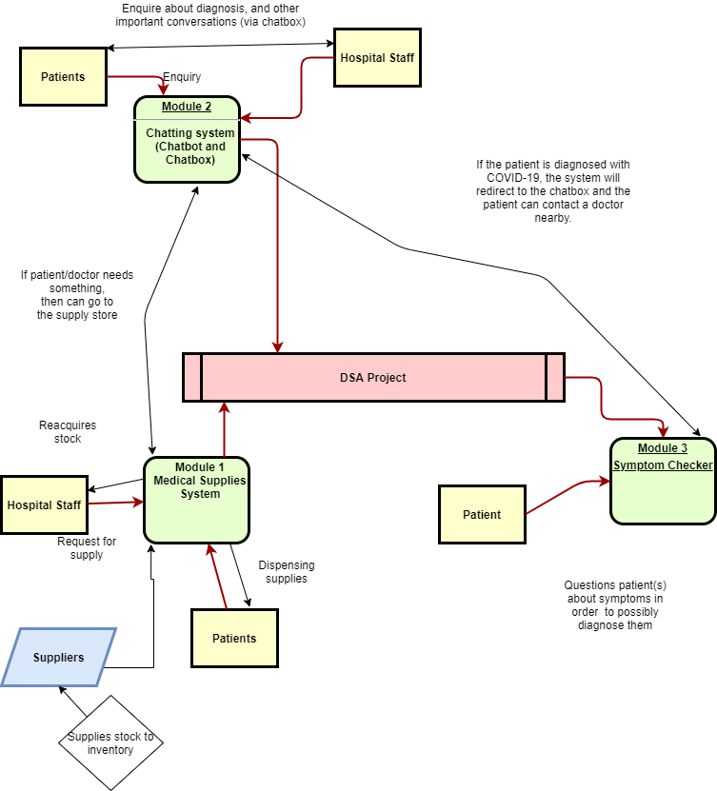

Slide 6
Abstract
“A man ate a bat and now I cannot go to my favourite restaurant,A man ate a bat and I can’t eat a pizza by home delivery.A man ate a bat and I have to stare at a screen for 12 hours a day and my sleep schedule has been utterly destroyed.”
-Anonymous Student
In India, the Covid-19 deaths per million population stand at 20.4 per million(subject to change) which is amongst the lowest in the world.Our Prime Minister enforced a lockdown which at a certain degree was the correct movie.The patients being brought in to various medical facilities took a toll over the administration and the entire system in various systems just broke down.Lives were lost due to sheer recklessness on doctor’s part and some were made to suffer due to lack of resources.
The reason for low supplies in hospital is that the system is too complex and also requires a person to go blind on paperwork related to supplies.Private hospitals which admits less patients have supplies in abundance which are not being used due to high admission rates and civil hospitals are being overcrowded with people who are not getting oxygen cylinders,attention or medicines to stablilize their pitiful conditions.
Our project which has functionalitites to last beyond this ‘pandemic era’ allows for simple ordering of medical supplies and equipments using stacks and arrays for a single medical facility.In addition,we integrate an interactive UI which helps in easy establishment of communication behind program and user.Our users include both medical staff and patients.In addition,we provide a medical staffer to update the list of items and provide payment options for purchasing with a calculated amount by way of material and quantity.
We have included a chatbot which caters to both users and doctors by giving appointments,assigning ambulances and providing details on driver,state and estimated time of arrival including other necessary hands-on information.
There’s a symptom checker built for particularly the novel COVID-19 which takes necessary details on patients and gives a probability of if a person has been infected with the virus and upto which level is he in danger of having contracted the virus.

Slide 7

Website to link our modules

Slide 8
Chatbot
A Data Structures and Algorithm Module

Slide 9
Analysis
Trees classify instances by sorting them down the tree from the root to some leaf node, which provides the classification of the instance. An instance is classified by starting at the root node of the tree,testing the attribute specified by this node,then moving down the tree branch corresponding to the value of the attribute as shown in the above figure.This process is then repeated for the subtree rooted at the new node.

Slide 10

Chatbot
The Chatbot(NAME:CASH) uses responses stored in an array to respond to various queries. It also gives pre-defined options for smoother user interaction.
Introduction
This is the hospital bot.It will provide contacts,find doctors reception schedule,make or cancel an appointment with a doctor.It can also call an ambulance if needed,
Reception Schedule
The reception schedule goes beyond the pandemic and offers to make appointments with surgeons,pediatricians and even gynaecologists.
Contacts
You can get the work hours of a facility and get an option to call a reception or administrating officer..
Others
You can call an ambulance,get a quote to keep your spirits up,call up the symptom checker.More updates will be rolled out over the progress eventually.

Slide 11
Time Complexities
Assuming that each node of the tree requires O(1) to execute, the complexity of the tree is bounded by its depth, e.g, longest route from the root to a leaf node.
Searching->Chatbot searches for function and traverses through all of them. Therefore, searching in binary tree has worst case complexity of O(n).
If chatbot could be self-balanced;difference between height of left sub-tree and right sub-tree of any node can’t be more than 1,complexity for executing a single fuction would be O(h) where h is the height of the tree.

Slide 12
Implementation
Hospital would be directed into creating an account on Snatchbot.They will then import the .snatchbot extension file available in the folder.They can then enter the doctor’s emails so that patient can reach them directly by chatbot through online consultation as shown in the video.

Slide 13
Features
Quotes->Keep yourself motivated in these troubled times.Pre-defines by using 2d matrix of characters in Snatchbot interface.
Call Ambulance->Use google maps to give present location which would be forwarded to assiged driver with the most efficient route.
Make appointment->Consult with a doctor online while you wait for emergency services to reach you and apply first-aid.
Call->Get ambulance,reception and administration number via chatbot with option to copy it directly to dialpad.

Slide 14
Plugins Available
There are 5 types of plugins available:
eBay - for a quick search of goods on eBay.
Giphy - a service for searching gifs or stickers.
Weather - a plugin that allows you to get a weather forecast for any city you want.
Calendar - access to your Google calendar. Authorization required.
Jira - using Jira via bot. Authorization required. Your domain must start with “https://”.
Trello - with this plugin, your users will be able to create, view, edit or remove the Boards that they own or have access to, Lists, Activities, Cards and Notifications.
Google Maps API implemented manually.

Slide 15
Introducing Ambulance route feature
Google would never disclose their data structures for their various products but it takes a DSA Student to know the workings behind map applications.
Graphs are awesome data structures too. They are used to represent elements that share connections. The elements in the graph are called Nodes and the connections between them are called Edges.
Graphs can be directed, when their edges have a specific orientation, similar to one-way streets, or undirected, when their edges don’t have a specific orientation, similar to two-way streets.
Edges can have a value associated with them, called weight.
If a graph has many edges, it’s called a dense graph. Otherwise, if it has few edges, it’s called a sparse graph.
A series of connections can form a cycle if they create a path that lets you to return to the same node.
R-trees are tree data structures used for spatial access methods, i.e., for indexing multi-dimensional information such as geographical coordinates, rectangles or polygons.

Slide 16
Traversal through a Graph
2 ways possible->Breadth First and Depth-First Search
The Time complexity of both BFS and DFS will be O(V + E), where V is the number of vertices, and E is the number of Edges. This depends on the data strucure that we user to represent the graph.
The Breadth First Search (BFS) traversal is an algorithm, which is used to visit all of the nodes of a given graph. In this traversal algorithm one node is selected and then all of the adjacent nodes are visited one by one. After completing all of the adjacent vertices, it moves further to check another vertices and checks its adjacent vertices again.
The Depth First Search (DFS) is a graph traversal algorithm. In this algorithm one starting vertex is given, and when an adjacent vertex is found, it moves to that adjacent vertex first and try to traverse in the same manner.

Slide 17
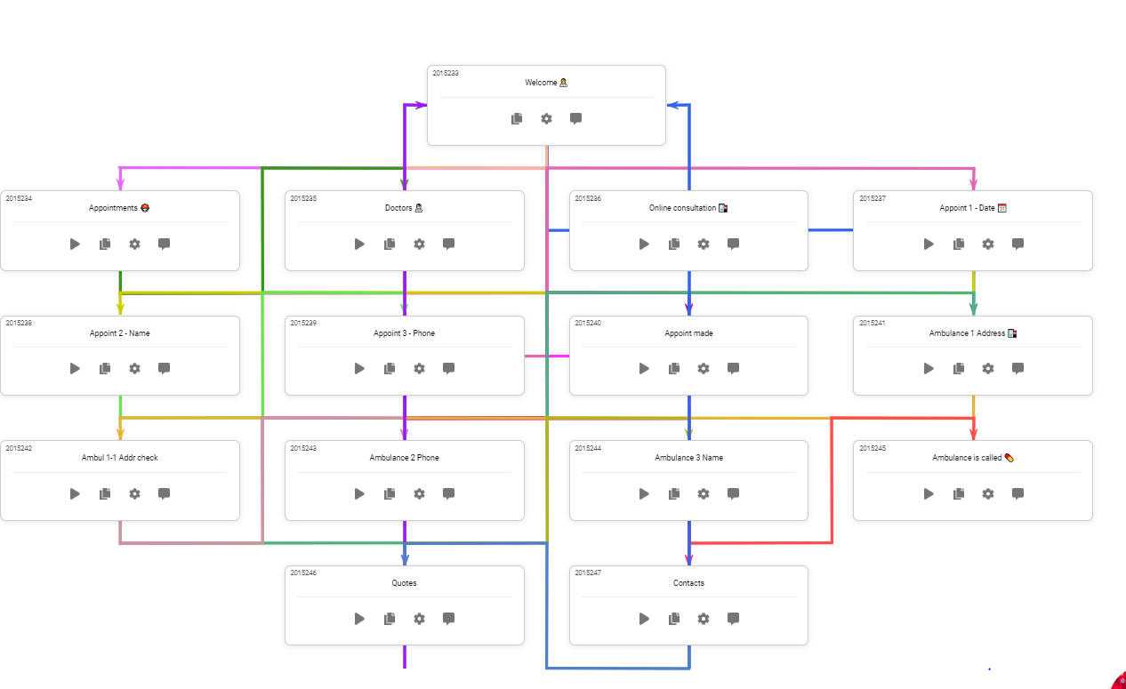
Bot Scheme

Slide 18
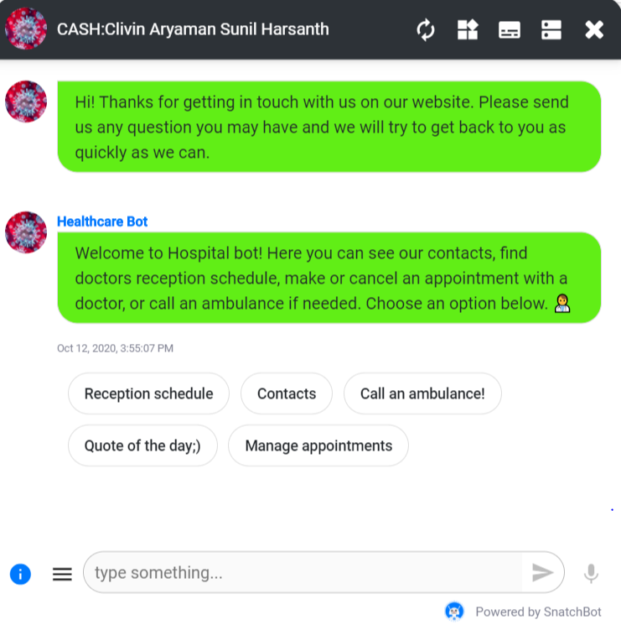
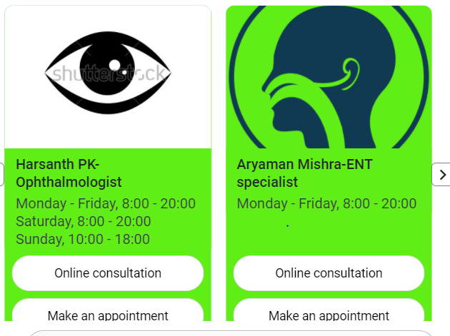

Slide 19
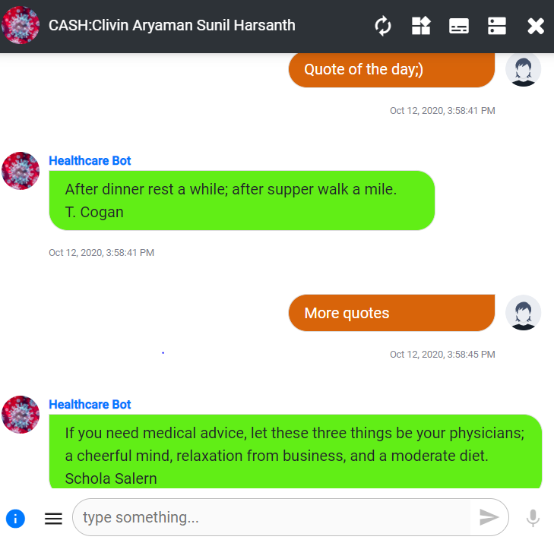
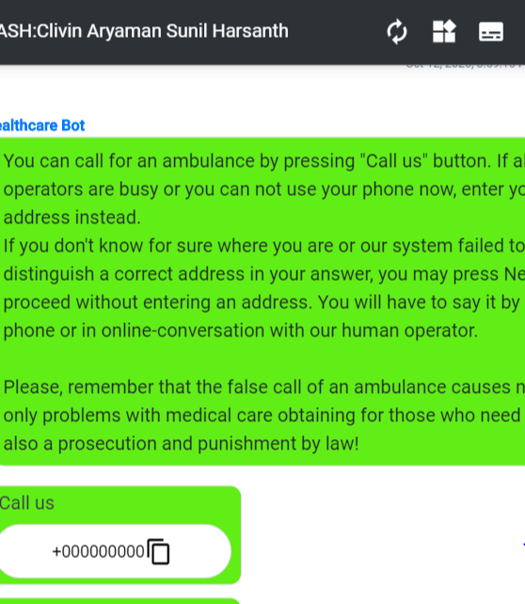

Slide 20

Medical Management System

Slide 21
Program Code
Please find code for Medical Management System where we have used Singly Linked List for updating product supplies list:
In case of corrupted file,please refer to the code given below: (Blurred lines is code in font size 1)
#include<stdio.h>
#include<stdlib.h>
#include<conio.h>
#include<string.h>
#include<windows.h>
#include<time.h>
///Logic Functions
/// Update & Insert Function
void insertfirst(int data, char supplies[25], int quantity, float price);
void insertmid(int pos, int data, char supplies[25], int quantity, float price);
void insertend(int data, char supplies[25], int quantity, float price);
void updatesupply(int udata, int uquantity);
/// Display Function
void supplylist();
void order_view(int order, int quantity, int or_no);
void main_menu();
///Delete & Count Function
void deletesupply(int serial);
int countitem();
///extra design Function
void cls();
void echo(char print[]);
void br(int line);
void pre(int tab);
void span(int space);
void ccolor(int clr);
void pwellcome();
void loadingbar();
void middle1(void);
void middtab1(void);
void backuploader(void);
///START Structure Here
struct Node{
char supplies[50];
int quantity;
float price;
int data;
struct Node *next;
};
///Global Type
typedef struct Node node ;
node *head, *list;
int main(){
system("mode con: cols=80 lines=30");
loadingbar(); cls();
pwellcome();
Sleep(300);
cls();
int c=0; int any;
int cardno[100];
float cardmoney[100];
float totalmoney = 0;
int total_order[100];
int order_quantity[100];
int order=0;
int uquantity;
int citem;
head = NULL;
insertfirst(5,"Masks",23,120.23);
insertend(6,"Syringes",13,100.67);
insertend(1,"Cough Syrups",8,720.83);
insertend(2,"First Aid Kits",46,70.23);
insertend(3,"Hazmat Suits",46,70.23);
insertend(4,"Stethoscope",34,60.23);
insertend(7,"Thermometer",7,520.29);
insertend(8,"Antibiotics",121,35.13);
insertend(9,"Antiseptics",73,20.13);
mainmenu:
br(1);
main_menu();
int main_menu_choice;
br(1); pre(4); fflush(stdin); scanf("%d",&main_menu_choice);
if((main_menu_choice >=1 && main_menu_choice <=3)){
if(main_menu_choice == 1){
supplylist:
cls();
printf("=> 0. Main Menu ");
supplylist();
}
else if( main_menu_choice == 2){
adminpanelchoice:
int admin_panel_choice;
cls(); middle1() ; pre(4); printf("1. Main Menu\n\n\t"); Sleep(300);
printf("Please Enter Password or ( 1 to Back in Main Menu ) : ");
fflush(stdin); scanf("%d",&admin_panel_choice);
if(admin_panel_choice==123321){
node *temp;
temp = list;
adminchoise:
cls(); br(5); pre(4); echo("You are on Admin Pannel\n\n");
pre(4);
printf(" 1. Total Cash Today \n\n");Sleep(250);pre(4);
printf(" 2. View Card Pay \n\n");Sleep(250);pre(4);
printf(" 3. Add supply \n\n");Sleep(250);pre(4);
printf(" 4. Delete Supply \n\n");Sleep(250);pre(4);
printf(" 5. Instant supply List \n\n");Sleep(250);pre(4);
printf(" 6. Item Counter \n\n");Sleep(250);pre(4);
printf(" 7. Backup System\n\n");Sleep(250);pre(4);
printf(" 8. Instant Order Preview\n\n");Sleep(250);pre(4);
printf(" 0. Main Menu ");Sleep(250);
int adminchoise;
fflush(stdin); scanf("%d",&adminchoise);
if(adminchoise==1){
cls(); middle1(); pre(4); printf("Todays Total Cash : %0.2f \n",totalmoney);
Sleep(2000);
goto adminchoise;
}
else if(adminchoise==2){
if(c!=0){
cls(); br(3); pre(4);
printf(" ____________________________\n");pre(4);
printf("| Card NO. | Money $ |\n");pre(4);
printf("------------------------------\n");pre(4);
for(int z=1; z<=c;z++){
printf("| %d | %0.2f |\n",cardno[z],cardmoney[z]);pre(4);
printf("------------------------------\n");pre(4);
Sleep(150);
}
Sleep(1500);
}
if(c==0){
cls(); middle1(); pre(4);
printf("No Card History\n");}
Sleep(1500);
goto adminchoise;
}
else if(adminchoise==3){
supplyadd:
cls();
char fsupplies[25];
int fquantity;
int fdata;
float fprice;
int fposi;
br(3);pre(4); printf(" Enter Supply Name : ");
fflush(stdin); scanf("%[^\n]s",fsupplies);
fquantity:
fflush(stdin);
br(2);pre(4); printf(" Enter Supply Quantity : ");
scanf("%d",&fquantity); fflush(stdin);
supplyserial:
br(2);pre(4); printf(" Enter Supply Serial : ");
scanf("%d",&fdata);
node *exist;
exist = list;
while(exist->data!=fdata){
if(exist->next==NULL){
break;
}
exist=exist->next;
}
if(exist->data==fdata){
cls(); br(5);pre(3); printf(" Supply Serial Already Exist, Please Re-Enter "); Sleep(2000);
goto supplyserial;
}
fprice:
fflush(stdin);
br(2);pre(4); printf(" Enter Supply Price : ");fflush(stdin);
scanf("%f",&fprice);
br(2);pre(4); printf("Submiting your data");for(int cs=0;cs<4;cs++){printf(" .");Sleep(500);}
insertend(fdata,fsupplies,fquantity,fprice);
br(2);pre(4); printf("Adding supply Successfull....\n");
Sleep(2000);
goto adminchoise;
}
else if(adminchoise==4){
cls();
middle1();pre(2);
printf("Enter Serial No of the supply To Delete : ");
fdelete:
int fdelete;
fflush(stdin); scanf("%d",&fdelete);
node *temp;
temp=list;
while(temp->data != fdelete){
temp = temp->next;
}
if(temp->data==fdelete){
deletesupply(fdelete);
}
else{
br(2); pre(2); printf("Please Enter Correct Number : "); Sleep(500);
goto fdelete;
}
goto adminchoise;
}
else if(adminchoise==5){
cls(); supplylist(); Sleep(1000);
br(2);pre(4); printf("1. <-- back \n\n");pre(5);
fflush(stdin); scanf("%d",&any);
goto adminchoise;
}
else if(adminchoise==6){
citem = countitem();
cls();
for(int cs=1;cs<=citem;cs++){
middle1(); pre(4);
printf("Item Counting ");
printf(" %d ",cs);
Sleep(150);
cls();
}
cls();
middle1();pre(4);
printf("Total Supply Item is --> %d \n",citem); Sleep(2000);
goto adminchoise;
}
///Backup System
else if(adminchoise==7){
char date[35]=__DATE__;
strcat(date,".txt");
FILE *fptr;
fptr=fopen(date,"w");
backuploader();
if(fptr==NULL){
br(3); pre(3); printf("Error!"); Sleep(500);
goto adminchoise;
}
fprintf(fptr,"Total Cash Today : %0.2f\n\n\n",totalmoney);
fprintf(fptr,"Card No ------- Money \n\n");
for(int l=1; l<=c;l++){
fprintf(fptr,"%d ------- %0.2f \n",cardno[l],cardmoney[l]);
}
br(2);pre(4); printf("Backup Successfull..."); Sleep(1500);
fclose(fptr);
goto adminchoise;
}
else if(adminchoise==8){
cls();br(2);pre(2);
ccolor(26);
printf("\n\t\t"); ccolor(240);
printf("______________________________________________________ "); ccolor(26);
printf("\n\t\t"); ccolor(240);
printf("| Order No. | Supply Name | Quantity | In Stock |"); ccolor(26);
printf("\n\t\t"); ccolor(240);
printf("------------------------------------------------------"); ccolor(26);
for(int o=1;o<=order;o++){
order_view(total_order[o],order_quantity[o],o);
}
br(2);pre(4); printf("1. <-- back \n\n");pre(5);
fflush(stdin); scanf("%d",&any);
goto adminchoise;
}
else if(adminchoise==0){
goto mainmenu;
}
else{
br(2); pre(4); printf("Please Select From List : "); Sleep(500);
goto adminchoise;
}
}
else if(admin_panel_choice==1){
goto mainmenu;
}
else{
br(2); pre(4); printf("Please Enter Correct Choice");
goto adminpanelchoice;
}
}
else if(main_menu_choice==3){
cls();
middle1(); pre(3); printf("Thank You For Using Our System \n\n\n\n\n\n\n");
Sleep(1000);
exit(1);
}
}
else{
br(2); pre(4); printf("Please Enter Correct Choice"); Sleep(300);
goto mainmenu;
}
int get_supply_choice;
br(2); pre(3);fflush(stdin); printf("Place Your Order: ") ; scanf("%d",&get_supply_choice);
if(get_supply_choice==0){
goto mainmenu;
}
node *temp;
temp = list ;
while(temp->data != get_supply_choice){
temp = temp->next;
if(temp==NULL){
br(2); pre(4); echo("Please Choice From List "); br(2); Sleep(1000);
goto supplylist;
}
}
if(get_supply_choice == temp->data){
fcquantity:
br(2); pre(4); printf("Enter Supply Quantity : ");
int fcquantity;
fflush(stdin); scanf("%d",&fcquantity); cls();
if(fcquantity==0){
cls(); middle1();pre(3); printf("Quantity Can not be Zero "); Sleep(2000);
cls();
goto supplylist;
}
else if(fcquantity>temp->quantity){
cls(); middle1();pre(3); printf("Out of Stock ! "); Sleep(2000);
goto supplylist;
}
middle1();pre(4); printf("Choice Supply %s its price is %0.2f \n\n",temp->supplies,temp->price*fcquantity);pre(4);
printf("1. Confirm to buy this \n\n");pre(4);
printf("2. supply List ");
confirm:
int confirm;
fflush(stdin); scanf("%d",&confirm);
if(confirm == 1 ){
br(2);pre(4); printf(" 1. Cash ");
br(2);pre(4); printf(" 2. Credit ");
payment:
int payment;
fflush(stdin); scanf("%d",&payment);
if(payment==1){
totalmoney += temp->price*fcquantity;
order++;
total_order[order]=get_supply_choice;
order_quantity[order]=fcquantity;
uquantity = temp->quantity - fcquantity;
updatesupply(get_supply_choice,uquantity);
cls();middle1();pre(4); printf("===>THANK YOU<===");
br(2);pre(4); printf("Supply Ordered Successfully ...");
br(2);pre(4); printf("1. Wanna Buy Another Medical Item ? ");
br(2);pre(4); printf("2. Main Menu ");
psmenu:
int ps_menu;
fflush(stdin); scanf("%d",&ps_menu);
if(ps_menu==1){goto supplylist;}
else if(ps_menu==2){goto mainmenu;}
else{br(2);pre(4);printf("Please Choice from list : "); goto psmenu;}
}
///Credit Card Option
else if(payment==2){
int card_number[100];
c++;
cls();middle1();pre(4); printf("Enter Your Card No : ");
fflush(stdin); scanf("%d",&card_number[c]);
cardno[c] = card_number[c];
int pin;
br(2);pre(2); printf("Enter Your Card Pin [we never save your pin] : ");
fflush(stdin); scanf("%d",&pin);
cardmoney[c] = temp->price*fcquantity;
totalmoney += temp->price*fcquantity;
order++;
total_order[order]=get_supply_choice;
order_quantity[order]=fcquantity;
uquantity = temp->quantity - fcquantity;
updatesupply(get_supply_choice,uquantity);
br(2);pre(4); printf("Payment Success...");
br(2);pre(4); printf("1. Wanna Buy Another Medical Item ? ");
br(2);pre(4); printf("2. Main Menu ");
psmenu2:
int ps_menu2;
scanf("%d",&ps_menu2);
if(ps_menu2==1){goto supplylist;}
else if(ps_menu2==2){goto mainmenu;}
else{br(2);pre(4);printf("Please Choice from list : "); goto psmenu2;}
}
else{
br(2);pre(4); printf("Enter Choice from List : ");
goto payment;
}
} ///END Confirm Y/y
else if(confirm == 2){
goto supplylist;
}
else{
br(2);pre(4); printf("Enter Choise from List : ");
goto confirm;
} ///end confirm;
} ///end get supply choice if line
else{
br(2);pre(4); echo("Please Choice From List "); br(2); Sleep(300);
goto supplylist;
} ///end get supply choice
}
void cls(){
system("cls");
}
void echo(char print[]){
printf("%s",print);
}
void br(int line){
for(int i=0; i<line;i++){
printf("\n");
}
}
void pre(int tab){
for(int i=0; i<tab;i++){
printf("\t");
}
}
void span(int space){
for(int i=0; i<space;i++){
printf(" ");
}
}
void main_menu(){
cls();
br(5); pre(3); echo("===> 1. Supply List"); Sleep(400);
br(2); pre(3); echo("===> 2. Admin Panel"); Sleep(400);
br(2); pre(3); echo("===> 3. Exit"); Sleep(400);
// br(2); pre(3); echo("=> 4. Admin Panel"); Sleep(400);
br(1);
}
void insertend(int data, char supplies[25], int quantity, float price){
node *temp;
temp=(node *)malloc(sizeof(node));
temp->data = data;
temp->price = price;
temp-> quantity = quantity;
strcpy(temp->supplies,supplies);
temp->next = NULL;
if(head==NULL){
head = temp;
list = head;
}
else{
while(head->next != NULL){
head = head->next;
}
head->next = temp;
}
}
void insertfirst(int data, char supplies[25], int quantity, float price){
node *temp;
temp=(node *)malloc(sizeof(node));
temp->data = data ;
temp->price = price;
strcpy(temp->supplies,supplies);
temp-> quantity = quantity;
temp->next = head;
head = temp;
list = head ;
}
void insertmid(int pos, int data, char supplies[25], int quantity, float price){
node *temp;
temp=(node *)malloc(sizeof(node));
temp->data = data;
temp->price = price;
temp-> quantity = quantity;
strcpy(temp->supplies,supplies);
while(head->next->data != pos ){
head = head->next ;
}
temp->next = head->next;
head->next = temp ;
// free(temp);
}
void deletesupply(int serial){
node *temp;
temp=(node *)malloc(sizeof(node));
temp = list;
if(temp->data != serial){
while(temp->next->data != serial){
temp = temp->next;
}
if(temp->next->data == serial){
temp->next = temp->next->next;
cls();
printf("\n\n\n\n\t\t\tDeleting Item %d ",serial);for(int cs=0;cs<4;cs++){printf(" .");Sleep(400);}
printf("\n\n\n\n\t\t\tDeleted Successfylly \n"); Sleep(500);
}
else{
printf("\n\n\n\n\t\t\tsupply Item Not Found\n"); Sleep(500);
}
head = temp ;
}
else{
temp = temp->next;
cls();
printf("\n\n\n\n\t\t\tDeleting Item %d ",serial);for(int cs=0;cs<4;cs++){printf(" .");Sleep(400);}
printf("\n\n\n\n\t\t\tDeleted Successfylly \n"); Sleep(500);
head = temp ;
list=head;
}
}
void updatesupply(int udata, int uquantity){
node *temp;
temp = list;
while(temp->data!=udata){
temp = temp->next;
}
if(temp->data == udata){
temp->quantity = uquantity;
}
}
int countitem(){
node *temp;
temp = list;
int countitem=0;
if(temp==NULL){
countitem = 0;
}
else{
countitem = 1;
while(temp->next != NULL){
countitem++;
temp = temp->next;
}
}
return countitem;
}
void supplylist(){
ccolor(26);
printf("\n\t\t"); ccolor(240);
printf("______________________________________________________ ");ccolor(26);
printf("\n\t\t"); ccolor(240);
printf("| supply No. | supply Name | Price | In Stock |");ccolor(26);
printf("\n\t\t"); ccolor(240);
printf("-------------------------------------------------------");ccolor(26);
node *temp;
temp = list;
while(temp != NULL){
ccolor(26);
printf("\n\t\t"); ccolor(62);
printf("| %d | %s | %0.2f | %d |",temp->data,temp->supplies, temp->price, temp->quantity);
ccolor(26);
printf("\n\t\t"); ccolor(62);
printf("-------------------------------------------------------");
temp = temp->next ;
Sleep(100);
}
ccolor(26);
// free(temp);
}
void order_view(int order, int quantity, int or_no){
ccolor(26);
node *temp;
temp = list;
while(temp->data != order){
temp = temp->next;
}
if(temp->data == order){
ccolor(26);
printf("\n\t\t"); ccolor(62);
printf("| %d | %s | %d | %d |",or_no,temp->supplies,quantity,temp->quantity);
ccolor(26);
printf("\n\t\t"); ccolor(62);
printf("-------------------------------------------------------");
Sleep(100);
}
ccolor(26);
}
void ccolor(int clr){
HANDLE hConsole;
hConsole = GetStdHandle(STD_OUTPUT_HANDLE);
SetConsoleTextAttribute(hConsole, clr);
}
///HEERE PRINTF STYLE FUNCTION
void pwellcome(){
ccolor(26);
char welcome[50]="WELCOME";
char welcome2[50]=" TO";
char welcome3[50]=" MEDICAL SUPPLY ORDER";
char welcome4[50]=" MANAGEMENT SYSTEM";
printf("\n\n\n\n\n\t\t\t");
for(int wlc=0; wlc<strlen(welcome);wlc++){
ccolor(120+(wlc*9));
printf(" %c",welcome[wlc]);
Sleep(200);
}
ccolor(26);
printf("\n\n\t\t\t\t ");
for(int wlc2=0; wlc2<strlen(welcome2) ;wlc2++){
ccolor(160+(wlc2*9));
printf(" %c",welcome2[wlc2]);
Sleep(200);
}
ccolor(26);
printf("\n\n\n\t\t\t ");
for(int wlc3=0; wlc3<strlen(welcome3) ;wlc3++){
if(welcome3[wlc3]!='D'){
ccolor(121+(wlc3*4));
printf(" %c",welcome3[wlc3]);
}
else{
ccolor(11);
printf(" %c",welcome3[wlc3]);
}
Sleep(200);
}
ccolor(26);
printf("\n\n\n\t\t\t\t ");
for(int wlc3=0; wlc3<strlen(welcome4) ;wlc3++){
if(welcome4[wlc3]!='A' && welcome4[wlc3]!='E'){
ccolor(121+(wlc3*4));
printf(" %c",welcome4[wlc3]);
}
else{
ccolor(11);
printf(" %c",welcome4[wlc3]);
}
Sleep(200);
}
ccolor(26);
}
void loadingbar(void){
for (int i=15;i<=100;i+=5){
cls();
ccolor(26);
printf("\n\n\n\n\n\n\n\t\t\t\t");
printf("%d %% Loading...\n\n\t\t",i);
printf("");
for (int j=0; j<i;j+=2){
ccolor(160+j);
printf(" ");
ccolor(26);
}
Sleep(100);
if(i==90 || i==50 || i==96 || i==83){
Sleep(100);
}
}
}
void backuploader(void){
for (int i=15;i<=100;i+=5){
cls();
ccolor(26);
printf("\n\n\n\n\n\n\n\t\t\t\t");
printf("%d %% Backing UP DATA...\n\n\t\t",i);
printf("");
for (int j=0; j<i;j+=2){
ccolor(120+j);
printf(" ");
ccolor(26);
}
Sleep(50);
if(i==90 || i==50 || i==96 || i==83){
Sleep(50);
}
}
}
void middle1(void){
printf("\n\n\n\n\n\n\n");
}
void middtab1(void){
printf("\t\t\t\t\t");
}

Slide 22
Medical Supplies Management System
We will be making a C program to support the medical supplies management system which will be implemented using stack and SLL data structure/ADT . We will provide a program in which medical supplies with their stock and cost will be displayed for the user from which any of the items of any quantity(until stock runs out) can be bought and the payment can be done through cash or credit card . The stock and prices can be updated by the admin by accessing the admin panel.
This system is very helpful for patients to buy medicines and supplies such as masks and medical personnel such as doctors to refer the stock to prescribe required medicines to the patients and to order inventory for the hospital from the list.
This program can also be integrated with the chat bot so that the doctor or medical personnel can redirect a patient to buy the prescribed medicine or to look over the stock of medical supplies present in the hospital.
The SLL ADT is used to store the medicines and medical items in the list from which the user can select the products/

Slide 23
Data structure
We have used singly linked list for building this module.
The main was to reduce the amount of pointers that to be maintained as compared to DLL, eg: in case of insert we need to maintain 2 pointers next and previous so to reduce the extra space we used SLL.

Slide 24
Processes involved
In singly linked list;
Insertion (where new medical related stuffs are added by using next pointer and storing it)
Deletion (here we delete the product)
Updation (when a customer buys a product the content already in the list needs to be updated)
Searching (here the customer is provided with various options for searching there product).

Slide 25
Time complexity
Time complexity of the complete module is dependent on the user, as the user can decide when to terminate the module.
In case of insertion involved , we have 'n' as the size or total number of products, so theta(1) will be for insertion at average case and for worst case it would be 0(1).
In case of search , theta(n) in average case and in worst case it would be of 0(n).
In case of deletion ,average time complexity is of theta(1) and in worst case it is 0(1).

Slide 26
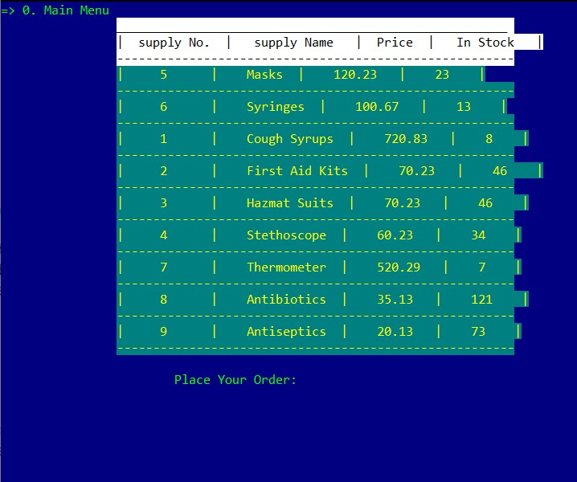
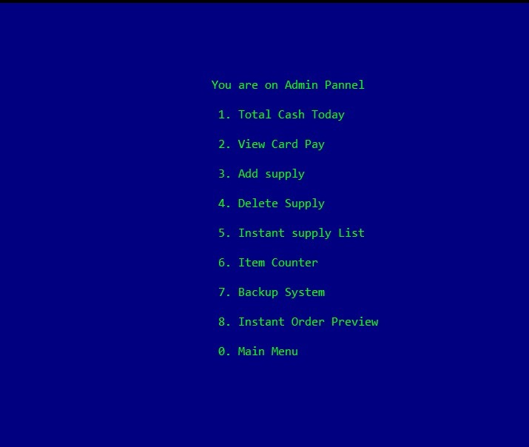
Screenshots

Slide 27
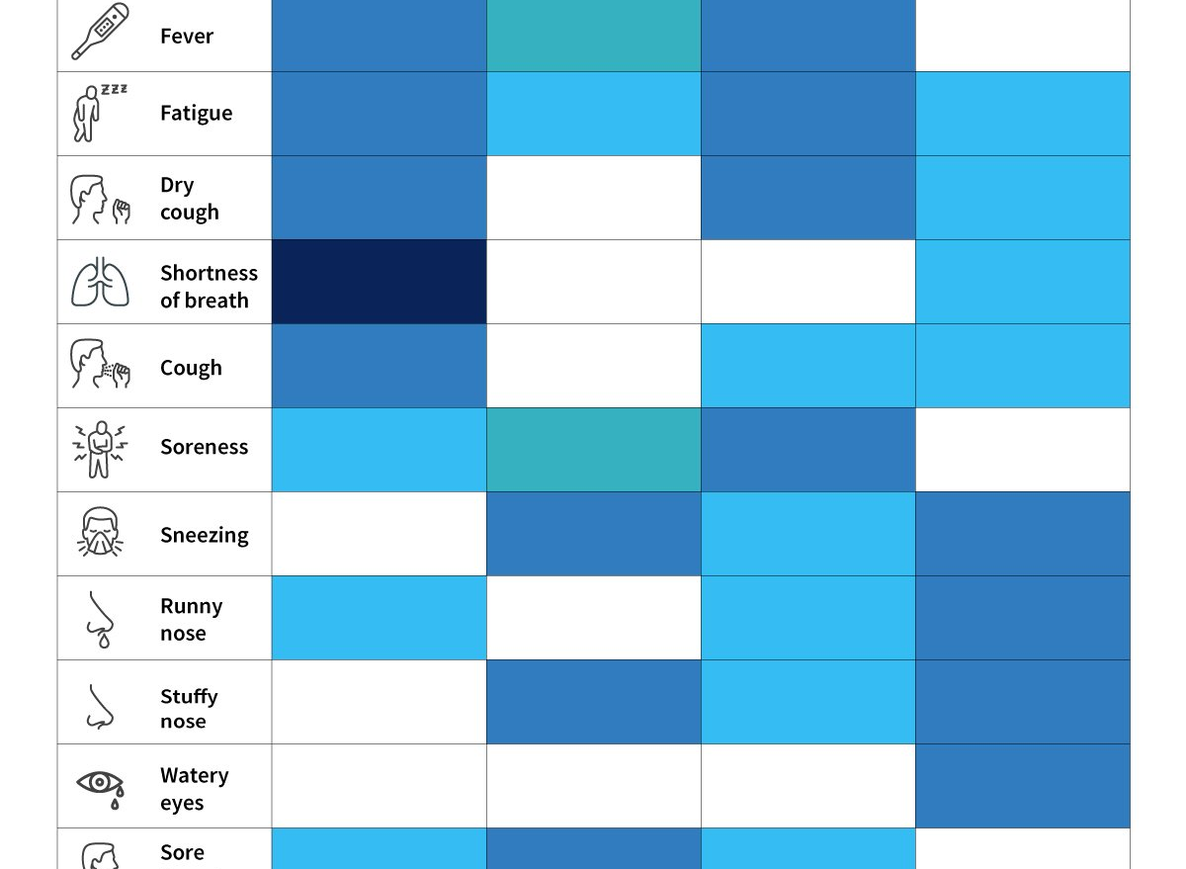
Symptom Checker
The Symptom Checker helps in diagnosing the user for COVID 19 with the help of Machine Language.The user will be asked several question related to finding about the existence of the above mentioned symptoms, and based on the input, the system will decide if the user has COVID 19 or not.The user input will be taken in as binary for easier comparison and will display the probability based on the input.

Slide 28
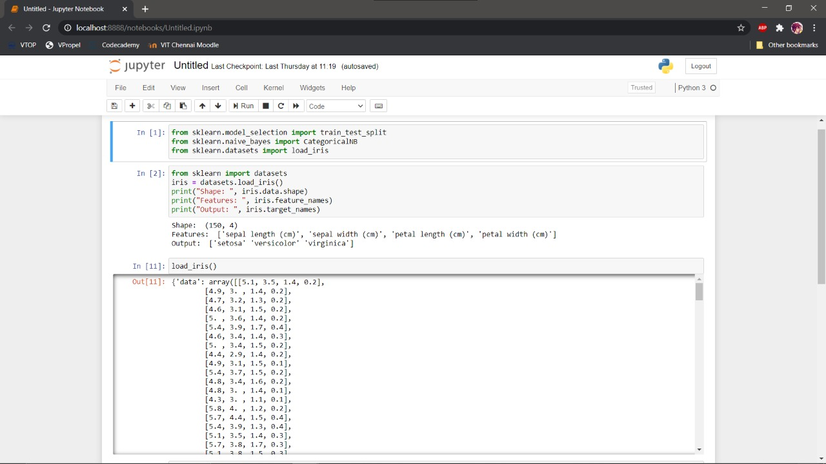
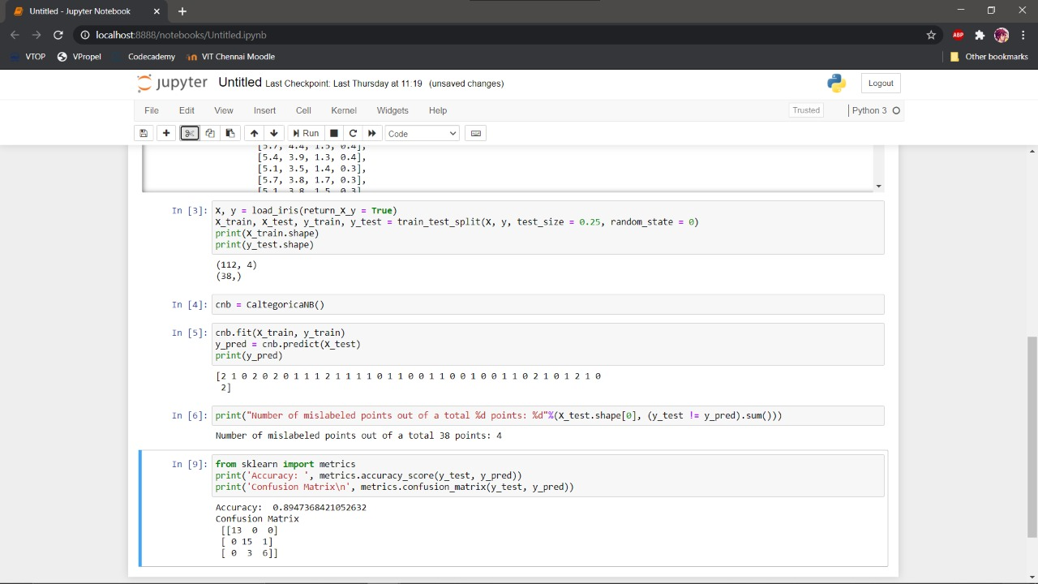

Slide 30
Progress
Project Review 1:
1)Idea confirmed.
2)Revision on Machine Learning done.
Project Review 2:
1)Chatbot has been added to the website to test modules linking with all functions and interactions operational.No plugins needed.Google Key API to be added 15 days before final review so as to last the trial period
2)Website has been made to accomodate access to all modules.
3)Program for our Medical Management System has been succesfully implemented.Addition of command prompt to run program in html yet to be added.
4)Machine Learning Notebook still in testing phase with other subjects for our Symptom Checker.
Project Review 3:
1)Stable Online IDE not found.Cannot run conio.h and windows.h package.
2)Chatbot implemented with API linking ambulance extraction to google maps.
3)Symptom Checker functional.
4)Website functional offline-no hosting yet.
5)Code fully functional along with admin priviledges.
6)Chatbot ready.

Slide 31
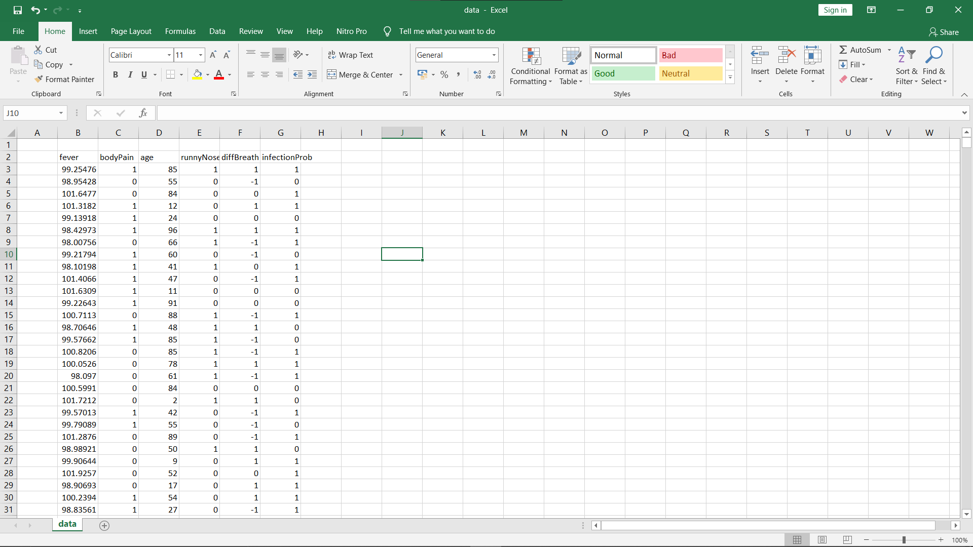
Data Structure is 2-dimensional array

Slide 32
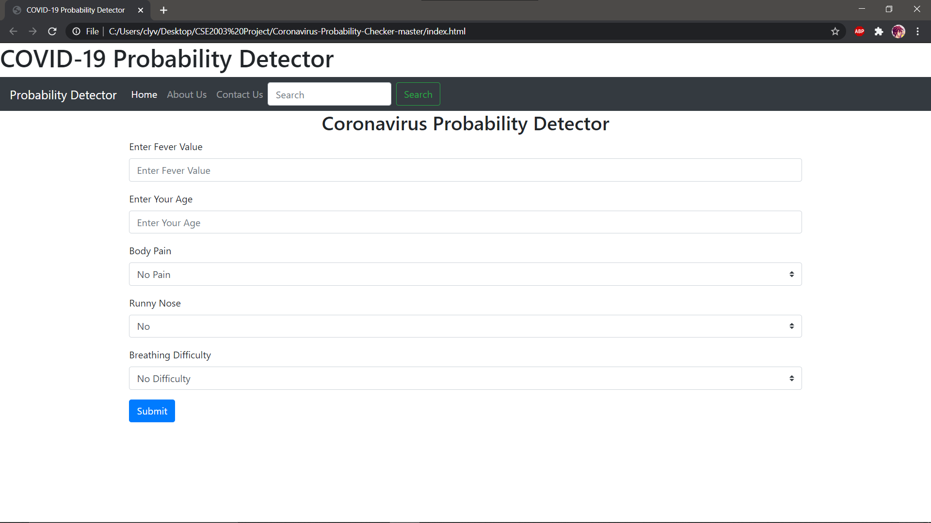
Time Complexity: O(1)

Slide 33
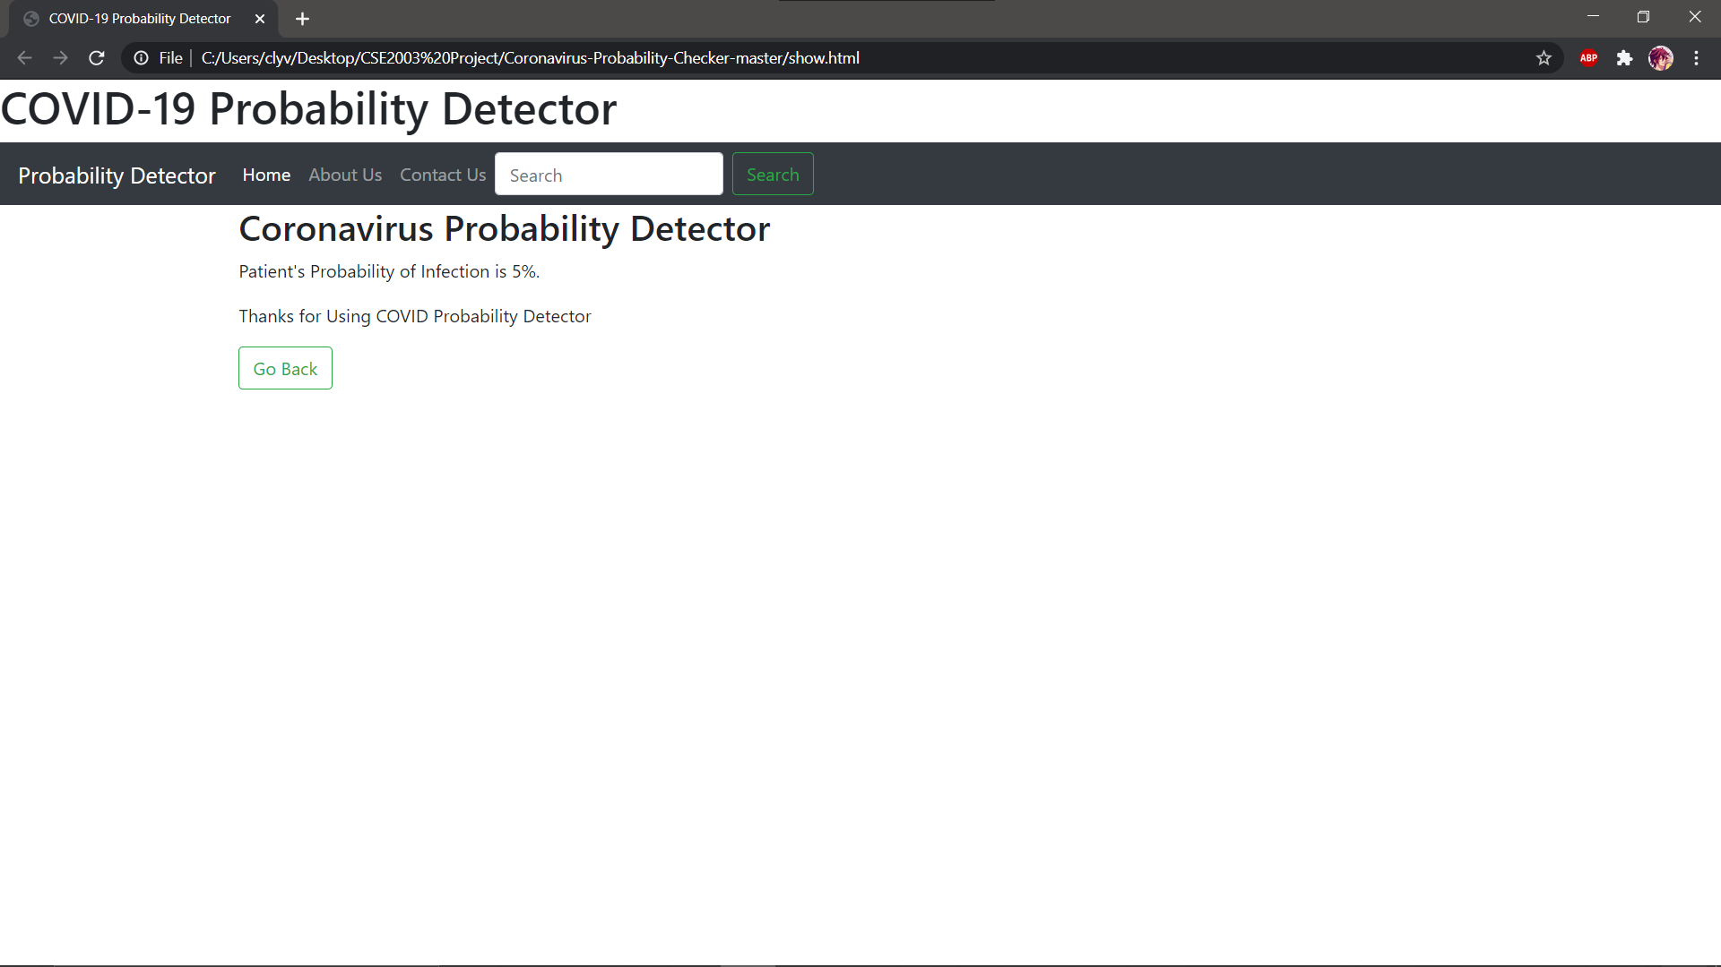
Time Complexity: O(1)

Slide 34
Future Enhancements
This was supposed to be a system for the pandemic but seeing the scale of it’s module can expanded to form a universal system.
Upcoming features:
Medicine Recommendation System(No need for meeting a doctor for prescribing)
Prescription Generator
Video Calling feature in Chatbot
Forum for Website for Trainees and Patients
Symptom Checker for more diseases

Slide 35
Experience
Aryaman->To me,it was a project to create something never done before by using data structures like trees,linked list and graphs to form a prototype of a chatbot to aid in the battle against the pandemic.I was lucky enough to get a team in these times which were more than able to stand up on this oppurtunity.I hope to keep developing unique stuff in the coming future.Our 2nd review went a bit awry but Sir’s guidance and kindness came through to inspire us to finish what we started.
Clivin->At first it was tough since I was yet to catch up on my ML algorithms but with the help of Arjun,Aryaman and Harsanth I was able to create a working symptom checker and learn even newer things in the field of ML and Deep Learning.
Harsanth->I loved this team which kept me motivated especially Aryaman whom I relentlessly disturbed at times so that he could tell me the ropes behind the development of these modules.It was a symbiotic relation in our team which helped us be better at understanding the concepts of Data Structures used in the project.I loved debugging these modules and creating a working website for this team.
Arjun->It was such an awesome experience with this team creating such a great project.It’s even more unbelievable that we may get a patent on our project.Well....another feather on our hats then.Thank you Sir for giving us this oppurtunity in developing such a great system.

Slide 36
Acknowledgements
Thanks to Sir Oswald for inspiring and guiding us throught this project.We couldn’t have got the chance on working on this has it not been for you.
Thanks go out to our Friends and Family for giving us tips to use in our projects.
Thanks Clivin for working yourself out over the symptom checker which is the most complex module in this project.
Thanks Harsanth for helping us in the coding and website.
Thanks Aryaman for developing the chatbot from scratch which works to greate extents.
Thanks Arjun for coding and helping us clear errors in our modules.

Slide 37
THANK YOU
Sir for hearing our idea and we will welcome any suggestions,including possible additions to the J-Component.

